Slide 1
Lecture 5 – Thread Execution Efficiency
CSD2170 Programming Massively Parallel Processors
Lecture 5.1 - Warps and SIMD Hardware

Slide 2
Objective
To understand how CUDA threads execute on SIMD Hardware
Warp partitioning
SIMD Hardware
Control divergence

Slide 3
Warps as Scheduling Units
Each block is divided into 32-thread warps
An implementation technique, not part of the CUDA programming model
Warps are scheduling units in SM
Threads in a warp execute in Single Instruction Multiple Data (SIMD) manner
The number of threads in a warp may vary in future generations
Block 1 Warps
Block 2 Warps
Block 3 Warps
…
…
…
…
…
…
t0 t1 t2 … t31
t0 t1 t2 … t31
t0 t1 t2 … t31

Slide 4
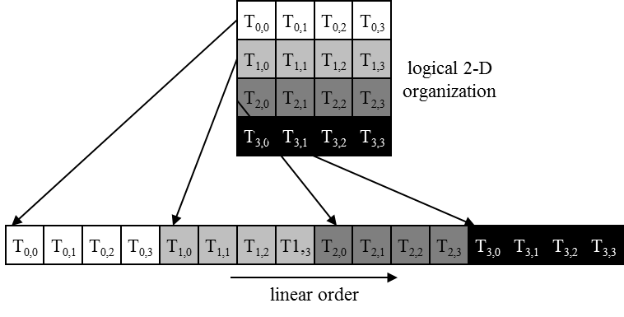
Warps in Multi-dimensional Thread Blocks
The thread blocks are first linearized into 1D in row major order
In x-dimension first, y-dimension next, and z-dimension last
Figure 6.1: Placing 2D threads into linear order

Slide 5
Blocks are partitioned after linearization
Linearized thread blocks are partitioned
Thread indices within a warp are consecutive and increasing
Warp 0 starts with Thread 0
Partitioning scheme is consistent across devices
Thus you can use this knowledge in control flow
However, the exact size of warps may change from generation to generation
DO NOT rely on any ordering within or between warps
If there are any dependencies between threads, you must __syncthreads() to get correct results (more later).

Slide 6
SMs are SIMD Processors
Control unit for instruction fetch, decode, and control is shared among multiple processing units
Control overhead is minimized (Module 1)
Memory
I/O
Processing Unit
Shared Memory
Register
File
ALU
Control Unit
PC
IR
Processor (SM)
Notes:
Insert von-neumann schematic here

Slide 7
SIMD Execution Among Threads in a Warp
All threads in a warp must execute the same instruction at any point in time
This works efficiently if all threads follow the same control flow path
All if-then-else statements make the same decision
All loops iterate the same number of times
Notes:
WARP_SIZE

Slide 8
Control Divergence
Control divergence occurs when threads in a warp take different control flow paths by making different control decisions
Some take the then-path and others take the else-path of an if-statement
Some threads take different number of loop iterations than others
The execution of threads taking different paths are serialized in current GPUs
The control paths taken by the threads in a warp are traversed one at a time until there is no more.
During the execution of each path, all threads taking that path will be executed in parallel
The number of different paths can be large when considering nested control flow statements
Notes:
WARP_SIZE

Slide 9
Control Divergence Examples
Divergence can arise when branch or loop condition is a function of thread indices
Example kernel statement with divergence:
if (threadIdx.x > 2) { }
This creates two different control paths for threads in a block
Decision granularity < warp size; threads 0, 1 and 2 follow different path than the rest of the threads in the first warp
Example without divergence:
If (blockIdx.x > 2) { }
Decision granularity is a multiple of blocks size; all threads in any given warp follow the same path

Slide 10
Example: Vector Addition Kernel
// Compute vector sum C = A + B
// Each thread performs one pair-wise addition
__global__
void vecAddKernel(float* A, float* B, float* C, int n)
{
int i = threadIdx.x + blockDim.x * blockIdx.x;
if(i<n) C[i] = A[i] + B[i];
}
Device Code

Slide 11
Analysis for vector size of 1,000 elements
Assume that block size is 256 threads
8 warps in each block
All threads in Blocks 0, 1, and 2 are within valid range
i values from 0 to 767
There are 24 warps in these three blocks, none will have control divergence
Most warps in Block 3 will not control divergence
Threads in the warps 0-6 are all within valid range, thus no control divergence
One warp in Block 3 will have control divergence
Threads with i values 992-999 will all be within valid range
Threads with i values of 1000-1023 will be outside valid range
Effect of serialization on control divergence will be small
1 out of 32 warps has control divergence
The impact on performance will likely be less than 3%

Slide 12
Lecture 5 – Thread execution Efficiency
CSD2170 Programming Massively Parallel Processors
Lecture 5.2 - Performance Impact of Control Divergence

Slide 13
Objective
To learn to analyze the performance impact of control divergence
Boundary condition checking
Control divergence is data-dependent

Slide 14
Performance Impact of Control Divergence
Boundary condition checks are vital for complete functionality and robustness of parallel code
The tiled matrix multiplication kernel has many boundary condition checks
The concern is that these checks may cause significant performance degradation
For example, see the tile loading code below:
if(Row < Width && ty * TILE_WIDTH+tx < Width) {
ds_M[ty][tx] = M[Row * Width + p * TILE_WIDTH + tx];
} else {
ds_M[ty][tx] = 0.0;
}
if (p*TILE_WIDTH+ty < Width && Col < Width) {
ds_N[ty][tx] = N[(p*TILE_WIDTH + ty) * Width + Col];
} else {
ds_N[ty][tx] = 0.0;
}

Slide 15
Two types of blocks in loading M Tiles
1. Blocks whose tiles are all within valid range until the last phase.
2. Blocks whose tiles are partially outside the valid range all the way
M
Type 1
TILE_WIDTH
Type 2

Slide 16
Analysis of Control Divergence Impact
Assume 16x16 tiles and thread blocks
Each thread block has 8 warps (256/32)
Assume square matrices of 100x100
Each thread will go through 7 phases (ceiling of 100/16)
There are 49 thread blocks (7 in each dimension)

Slide 17
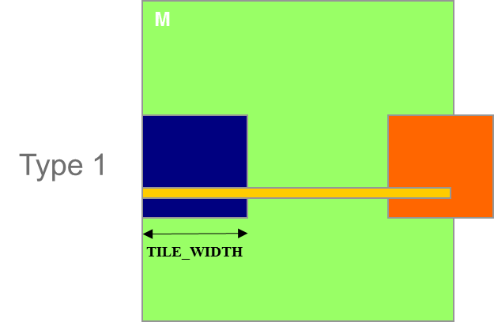
Control Divergence in Loading M Tiles
Assume 16x16 tiles and thread blocks
Each thread block has 8 warps (256/32)
Assume square matrices of 100x100
Each warp will go through 7 phases (ceiling of 100/16)
There are 42 (6*7) Type 1 blocks, with a total of 336 (8*42) warps
They all have 7 phases, so there are 2,352 (336*7) warp-phases
The warps have control divergence only in their last phase
336 warp-phases have control divergence

Slide 18
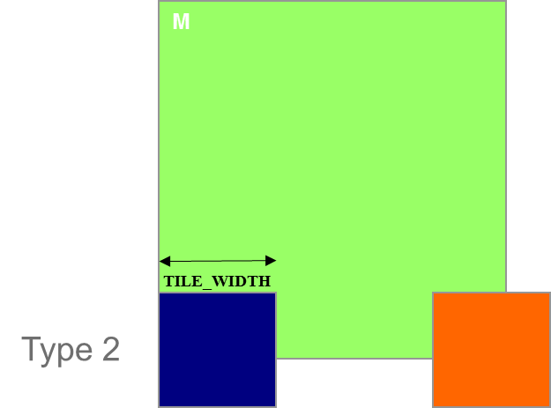
Control Divergence in Loading M Tiles (Type 2)
Type 2: the 7 block assigned to load the bottom tiles, with a total of 56 (8*7) warps
They all have 7 phases, so there are 392 (56*7) warp-phases
The first 2 warps in each Type 2 block will stay within the valid range until the last phase
The 6 remaining warps stay outside the valid range
So, only 14 (2*7) warp-phases have control divergence

Slide 19
Overall Impact of Control Divergence
Type 1 Blocks: 336 out of 2,352 warp-phases have control divergence
Type 2 Blocks: 14 out of 392 warp-phases have control divergence
The performance impact is expected to be less than 12% (350/2,744 or (336+14)/(2352+392))
M
Type 1
TILE_WIDTH
Type 2

Slide 20
Additional Comments
The calculation of impact of control divergence in loading N tiles is somewhat different and is left as an exercise
The estimated performance impact is data dependent.
For larger matrices, the impact will be significantly smaller
In general, the impact of control divergence for boundary condition checking for large input data sets should be insignificant
One should not hesitate to use boundary checks to ensure full functionality
The fact that a kernel is full of control flow constructs does not mean that there will be heavy occurrence of control divergence
We will cover some algorithm patterns that naturally incur control divergence (such as parallel reduction) in the Parallel Algorithm Patterns modules

